Slide 1
ManagementStudyGuide.com
Learn Management the Easy Way with the Help of Downloadable Power-point Presentations - Learn at Your Own Pace.
The Presentation contains Animation. To View the Course please run the “Slide Show”.
You Can Run the Slide Show by Using any one of the following options:
Click on the “Slide Show” in top menu bar, OR
Press the F5 Key
Register Now & Download Your Set of 6 Free Power-point Presentations with total of more than 1,000 Slides.

Slide 2
Brand
Management

Slide 3
Course Objectives
In this module, you will learn to:
Explain what is a Brand
Explain the importance of Brands
Describe the attributes of a strong brand
Explain what is Brand Management
Describe the Purpose of Brand Management
Explain the Brand Equity Concept
Describe the Strategic Brand Management Process
List the Strategic Brand Management Guidelines

Slide 4
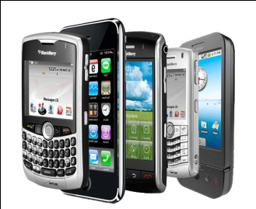
Introduction
The market is crowded with Nokia, Motorola, and Ericsson fighting it out at the top.
However, Nokia replaced all its competitors and it is now the number one brand in many markets around the world, effectively dislodging Motorola from that position.
The world of the mobile phone market is crowded. The diverse products available range from the simple to the complex and every manufacturer offers the latest features.
Also, several less successful brands like Samsung, Philips, Siemens and Panasonic are trying hard to make it into the top competitors' market share.
So what made Nokia special from others? Why did customers choose Nokia? The answer lies in what the ‘brand Nokia’ means to customers.

Slide 5
Introduction
It has made a conscious effort to manage consumer perceptions of its brand.
It escalated its position to become the number one brand in several markets around the world.
Nokia has succeeded by putting across the human face technology-taking and dominating the emotional high ground.
Technology
Nokia Group, a Finland-based manufacturer of mobile phones, has been steadily and consistently working on its corporate brand name over the years.
These efforts of creating a ‘brand’ image in the customer’s minds paid off for Nokia.
Nokia has successfully built a corporate brand that associates ‘trust’ and ‘strong technology’ with the word ‘Nokia’.
Thus, you can see that a strong brand leaves an imprint on the customer’s minds. Let us understand more about brands and brand management.

Slide 6
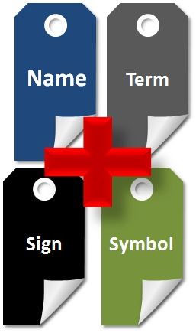
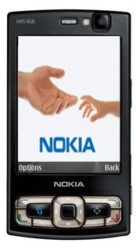
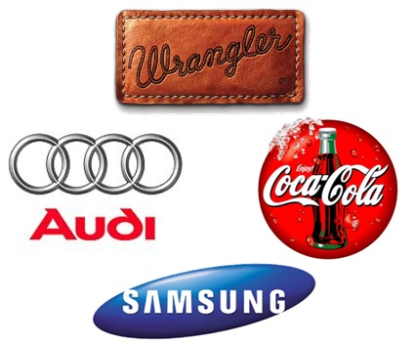
What is a Brand?
Nokia brand promises ‘trust’ and ‘strong technology’
The popular Starbucks has earned its brand image from the opinions of its customers.
The brand Starbucks stands for bolder, more flavorful coffee.
Thus, you can see that Brands are “what the consumers buy”, while products are “what concern/companies make”.
Brand is a promise that the product will perform as per customer’s expectations.
It is a name, term, sign, symbol or a combination of all these which differentiate the goods/services of one seller or group of sellers from those of competitors.
Some examples of well known brands are Wrangler, Audi, Samsung, Coca Cola, etc.

Slide 7
Gillette as a Strong Brand
Gillette’s tagline, 'The Best A Man Can Get’, showcased in its ads through the years has created a consistent, intangible sense of product superiority.
Gillette has created a strong brand image in totality - that is, all the different perceptions, beliefs, attitudes and behaviors customers associate with their brand.
To keep this strong brand presence, Gillette is very protective of the name carried by its razors, blades and associated toiletries. Hence, Braun is used for the company's electric razors and its oral care products are marketed under the name, Oral B.

Slide 8
What is Brand Management?
Now, that you have learnt about ‘brands’, let us see what is brand management.
Brand management is the process of building, managing and improving a brand.
It begins by having a thorough knowledge of the term “brand”.
Hence, brand management includes developing a promise, making that promise and maintaining it.
It means defining the brand, positioning the brand, and delivering the brand. It is an art of creating and sustaining the brand.

Slide 9
Brand Equity Concept
Brand Equity is the value, both tangible and intangible, that a brand adds to a product/service; the added value a brand name identity brings to a product or service beyond the functional benefits provided.
The concept of brand equity is measured in two terms:
Brand Equity
Customer-based
Market - based
The customer – based brand equity focuses exclusively on the relationship customers have with the brand
The market – based brand equity aims at producing measures in dollars, euros or yen.

Slide 10
Strategic Brand Management Process
The Strategic Brand Management Process consists of the following four steps:
Step 4
Step 1
Growing and Sustaining Brand Equity
Identifying and Establishing Brand Position
Strategic Brand Management Process
Measuring and Interpreting Brand Performance
Planning and Implementing Brand Marketing Programs
Step 3
Step 2

Slide 11
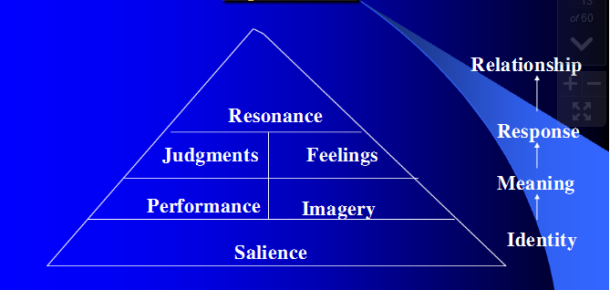
Step 1: Identifying & Establishing Brand Position
Customer Based Brand Equity
The Brand position can be identified and established by determining the customer-based brand equity using the pyramid.
Brand Salience: This relates to aspects of awareness of the brand.
Brand Performance: This relates to ways in which product/ service meets customers’ needs.
Brand Imagery: It’s how customers visualize a brand abstractly, with no relevance to what the brand actually does.
Brand Judgments: The customers’ personal opinions and evaluations with regard to the brand.
Brand Feelings: The customers’ emotional responses and reactions with respect to the brand.
Brand Resonance: The ultimate relationship &level of identification that the customer has with the brand.
Identifying and Establishing Brand Position
Customer Based Brand Equity
Brand Positioning
Identify and Establishing Brand Position
Building a Strong Brand: Four Steps of Brand Building
Positioning Guidelines

Slide 12
Choosing Brand Elements to Build Brand Equity - Options and Tactics for Brand Elements
Brand Elements
Options and Tactics for Brand Elements:
The following are few options and tactics for Brand Elements:
Brand Names:
URLs:
Logos and Symbols:
Descriptive brand names in which the function is described literally in brand name.
Keep the URLs as simple as possible,
Avoid clichés,
Use a new term for the real word
Use catchy phrases
Various kinds that can be used are:
Family Shields
Fonts
Suggestive brand names in which the name is suggestive of a benefit provided by the brand to the customer.
Symbols
Abstract – shapes and image

Slide 13
Brand Management Guidelines
Actively Integrate the Brand Management Strategy into Product Development and Launch Activities
It is important that the Companies actively integrate the brand strategy into product development and launch activities by using a clear and proactive strategy.
8
Affix Products & Services
An effective strategy of brand management is to ensure that the brand is associated to the most popular products and services offered by the licensee’s products and services.
7
Enforce Key Provisions through License agreements
Enforcing various important concerns such as quality control standards and reporting standards can be done through a properly charted out license agreements.
6
Decide about License Agreements:
The decision of whether the license agreement should be exclusive or non–exclusive will have important implications for all of the business.
5
Maximize the Strategic Advantage of the Brand
It is important that organizations focus on maximizing the leverage of the brand.
4
Select Proper License Partners
The profile of the ideal license partner should be developed and the focus should be to ensure long-term relationships with the licensors and licensees.
3
2
Maintain Consistency between the Brand Strategy and Overall Business Goals
The brand strategy should be in line with the overall business goals of the organization.
Establish and Maintain the Brand
It is necessary that for establishing and maintaining a brand, a holistic approach, or an “overall brand strategy” is used.
1
The following key points provide some strategic brand management guidelines that should be
adapted when developing and implementing a brand management strategy.

Slide 14
ManagementStudyGuide.com
Learn Management the Easy Way with the Help of Downloadable Power-point Presentations - Learn at Your Own Pace.
Just Download the Presentation and Run the Slide-Show.
This is a DEMO Course On – Brand Management. The Complete Course Consists of 90 Slides.
Click here to Register Now & Download Your Set of 6 Free Powerpoint Presentations with total of more than 1,000 Slides.75 Courses Added So far with more than 15,000 Slides + New Courses Added Every Week. – Click here to Go to All Courses

